Slide 1

Project 2
By: Jerry Contreras

Slide 2
Outline Coverage
Purchasing
In-House Metrics
Predictive

Slide 3

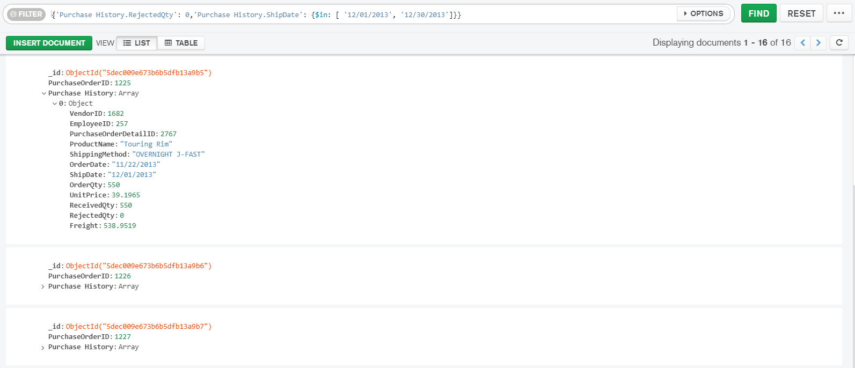
Purchasing
They were 16 documents returned for purchased item bought from vendors between 12/01/13 – 12/30/13, that had a 0 rejected quantity rate. These documents represent dependable vendors during the end of the year, and we should continue to have good relations with them for the upcoming years.

Slide 4
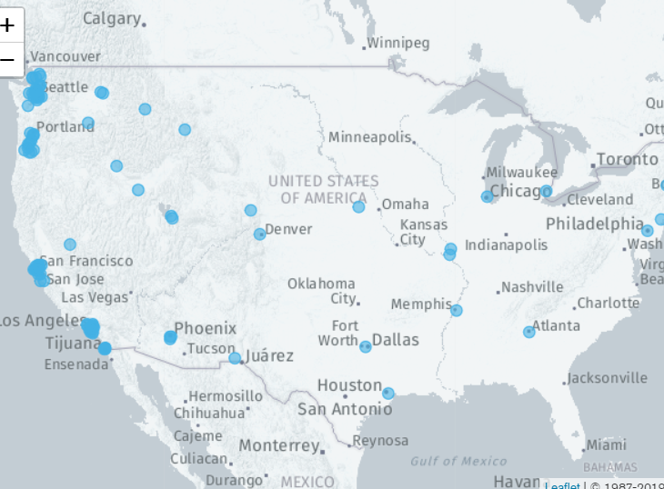

Purchasing
We have lots of vendors that are far away from our headquarters (Washington), maybe we might should consider other vendors closer than that maybe aren’t as notorious but this would significant reduce shipping cost over long periods of time.

Slide 5
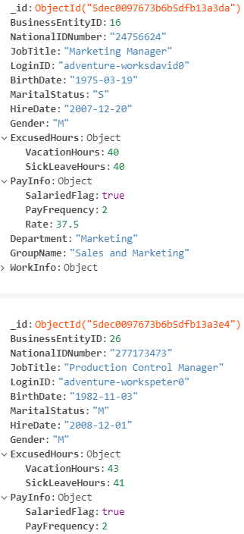
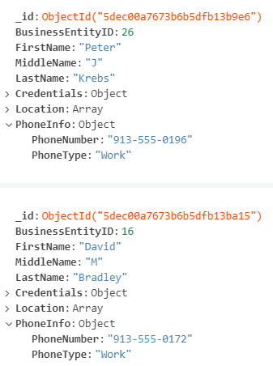
In-House Metrics
MongoDB Query 1:
MongoDB Query 2:
The first query find employees in the HumanResourceCollection that took vacation hours and sick leave hours between 40 to 45 hours in the last year, who also happened to be salaried.
This normally wouldn’t be too concerning if the employees were hourly but we are paying for every they take
The next query just simply finds the their name and contact information in the BusinessEntityCollection
We should continue to monitor these two behaviors over the next year to see if we can see any reoccurring trends to determine if they are actually sick or just don’t want to come into work.

Slide 6

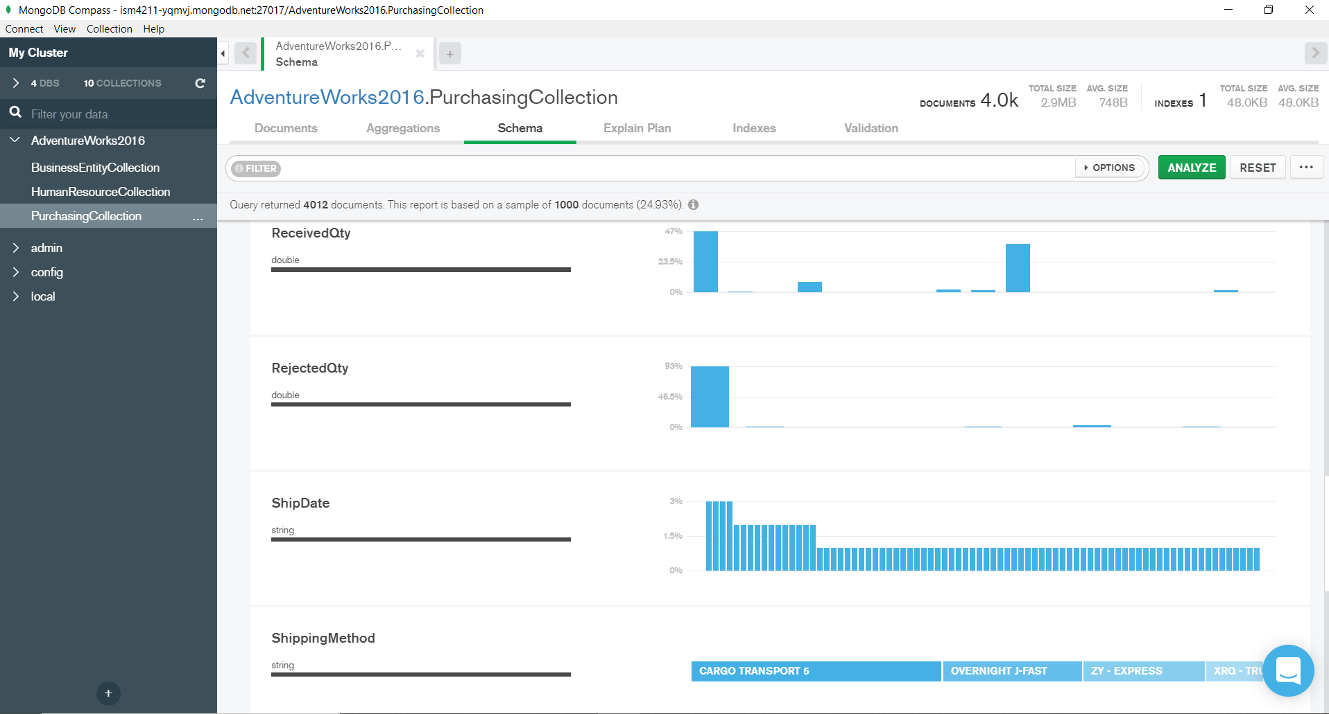
The Predictive Cycle
Planning
Feedback
Adjust
Iterate
Overall, we’re doing pretty good, we just need to keep the information cycle going to remain agile

